Slide 1
Nepal Monitor Predictive Analysis
SpringBoard Capstone 1
Neil Horning

Slide 2
Contents
Client / Business Problem
Exploratory Data Analysis
Time Series Analysis
Findings and Next Steps

Slide 3
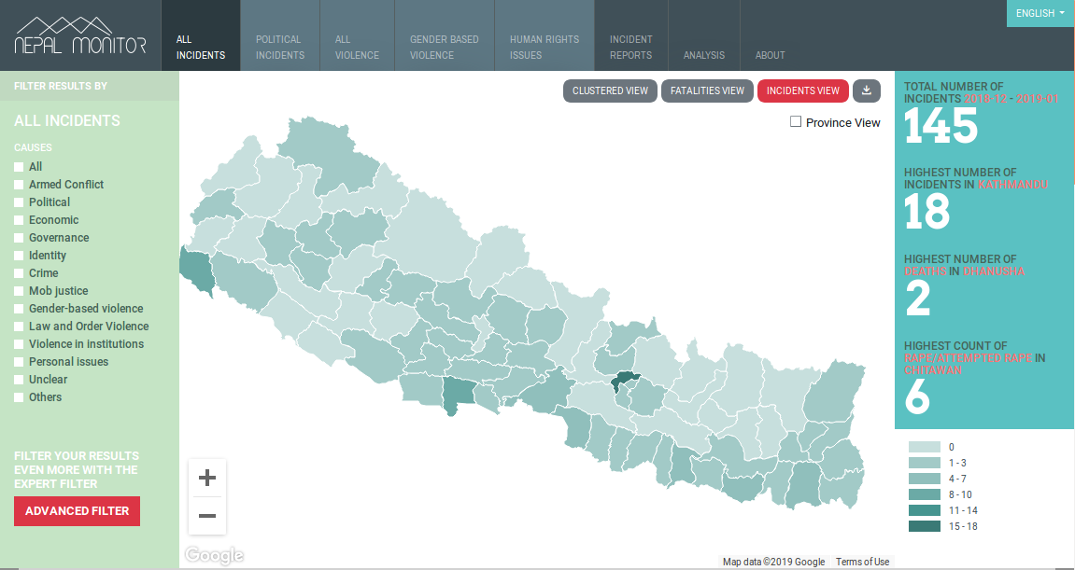
Client - Nepal Monitor
NepalMonitor.org homepage
The Nepal Monitor Project (NMP) comprehensively maps human rights and violence data across Nepal to improving understanding, better respond to it, and promote peace.

Slide 4
To be an effective early warning system, Nepal Monitor should answer two main questions:
What violence is likely to happen where, and when?
What variables predict that?

Slide 5
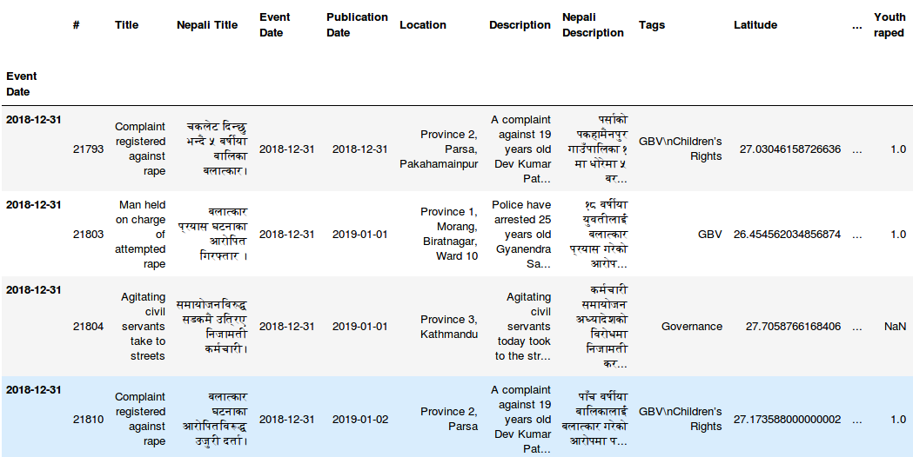
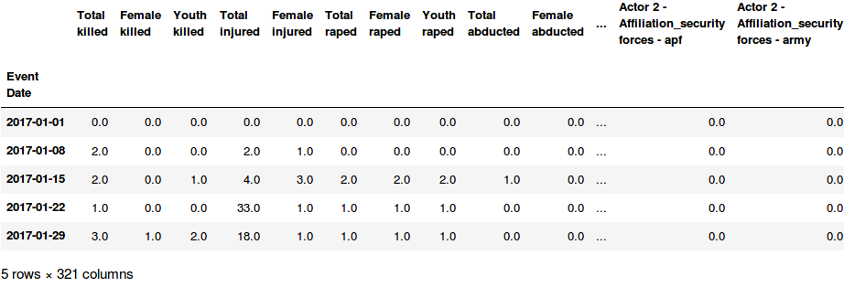
Exploratory Data Analysis
Data:
Nepal Monitor Export
Individual incidents
Dated, Geocoded, categorized
Subject to federal restructuring and website revamp
Boundary Hierarchy 2017: Ward < VDC < District < Zone
‘’ 2018: Ward < Palika< District < Province
2011 Ward level population census
Ward Boundary Shapefile
Exported to calculate area and population density
Data Cleaning:
Normalized timestamps so that only dates remained
Removed unnecessary columns
Converted yes and no values to 1’s and zeros
Data Wrangling:
Separated out impacts of 2017 incident data for analysis
Created dataframe of impacts grouped by date
Created dataframe of impacts grouped by district joined with province number and district population data.
Created a dataframe of incidents grouped by VDC and joined with VDC level census data
Created “dummy columns” for variables tracked by the NMP project, making the dataset 375 columns wide.
Aggregated by week and processed into timeshifted dataframe for time series analysis

Slide 6
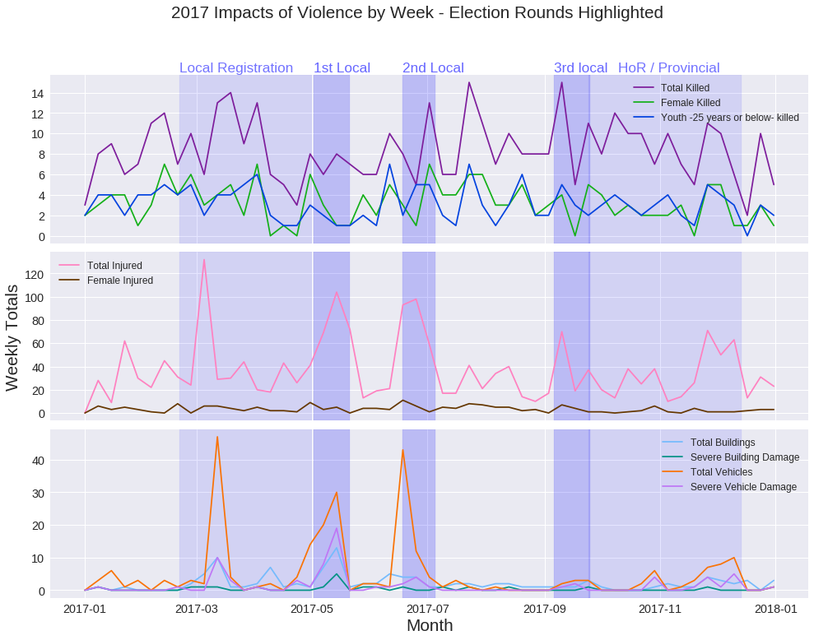
Is violence correlated with specific time periods?
Injuries and physical damage appear correlated with electoral rounds, while other impacts have no significant correlation with these periods.

Slide 7
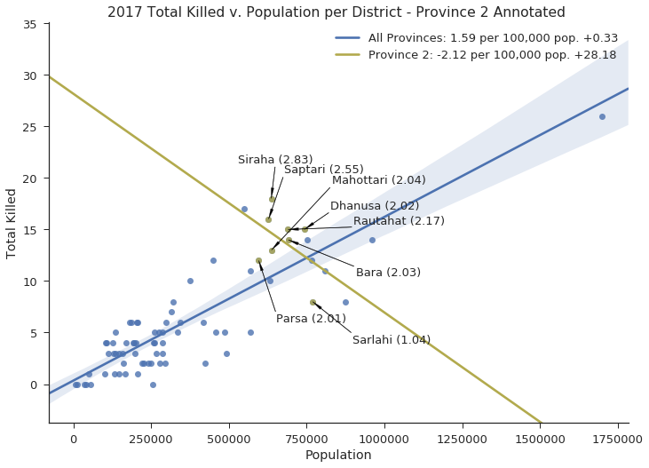
How does the distribution of violence differ between provinces?
Province 2 has the highest Total Killed among all the provinces and the highest population. It also has the tightest distribution of Total Killed per 100,000 people. And a negative regression line of violence per-capita.

Slide 8
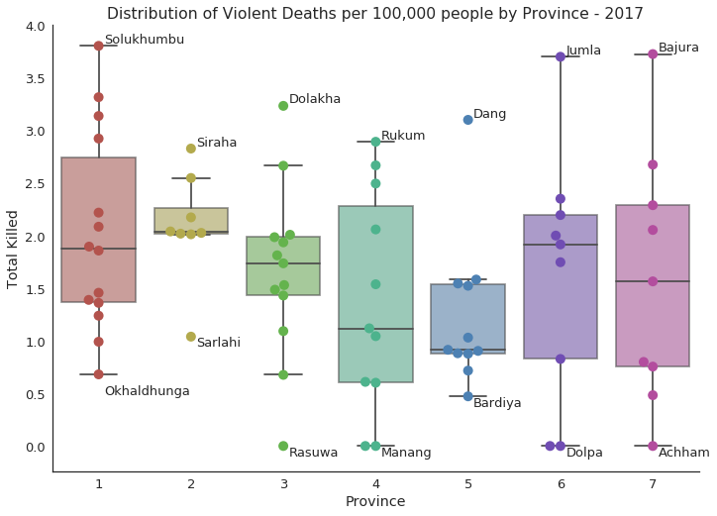
How does the distribution of violence differ between provinces?
The reason for the abnormal regression line of Province 2 is the outlier status of Sarlahi district. It has both the highest population and the lowest number of deaths.

Slide 9
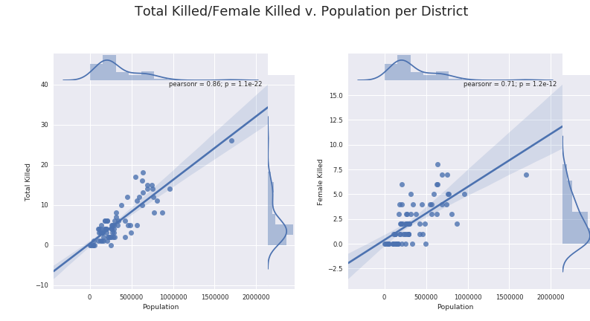
What variables predict violence?
There are significant relationships between district population and certain impacts of violence, the highest being with Total Killed

Slide 10
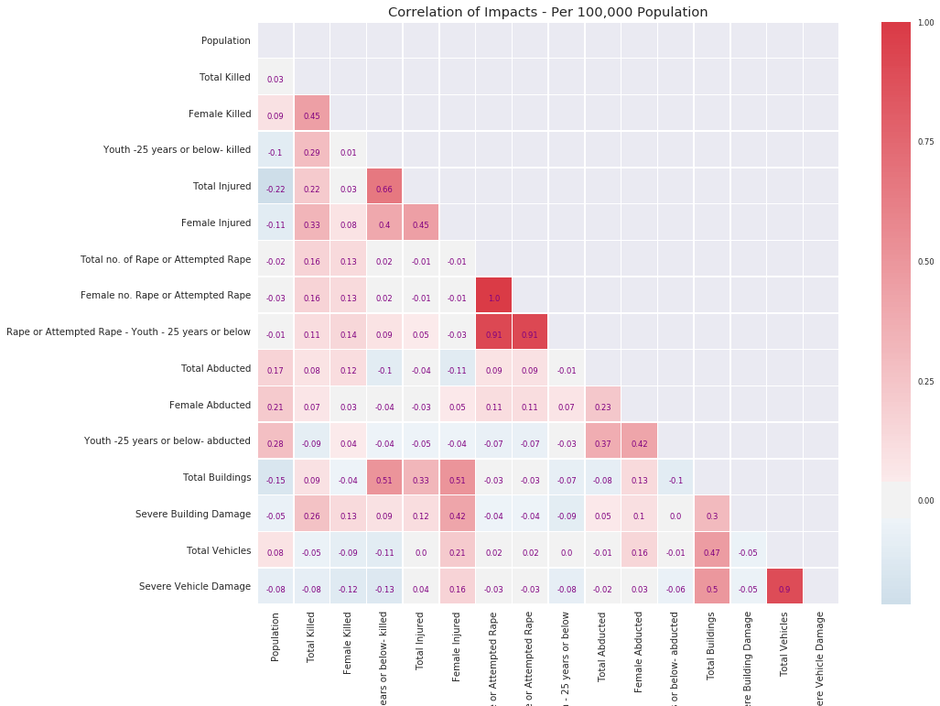
Plotting pairs of impacts in a heatmap reveals a relationship between injuries, youth killed, and and property damage (Buildings, Vehicles, etc) in 2017 - likely an effect of where demonstrations are taking place.

Slide 11
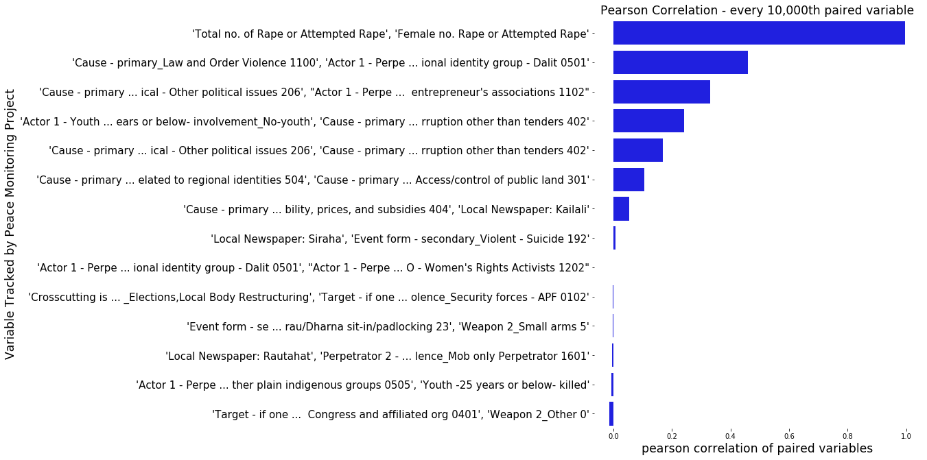
What variables predict violence? cont.
However, roughly 50% of all 132,076 possible variable pairs have some positive correlation. This highlights the need for machine learning in sorting out meaningful relationships.

Slide 12
Time Series
Analysis
Event Date | Total killed (t-004) | Total killed (t-003) | Total killed (t-002) | Total killed (t-001)
2018-12-09 | 8.0 | 2.0 | 6.0 | 3.0
2018-12-16 | 2.0 | 6.0 | 3.0 | 4.0
2018-12-23 | 6.0 | 3.0 | 4.0 | 3.0
X:
Train
Event Date | Total killed(t)
2018-12-09 | 4.0
2018-12-16 | 3.0
2018-12-23 | 4.0
To predict what will happen one week in the future, the model is fed what has happened several weeks prior (X) to a given set of weeks (y) and trains itself to find any relationship. It is then asked to guess what will happen in the next week (y_pred).
This is done in sequence for every week using multiple variables.
y:
Predict
Event Date | Total killed(t)
2019-01-01 | 4.2
y_pred:
Notes:
Need to make clear that results must be interpretable...

Slide 13
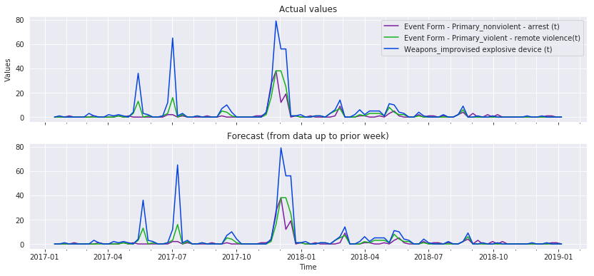
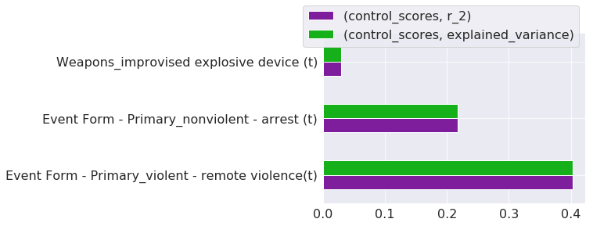
Baseline
Baseline scores are calculated by assuming that each variable will have the same value as the previous week, such as in the example variables above. Note the gridlines show the forecast lagging behind the ground truth by a week. r² and explained variance measure the degree actual values are predicted by the forecast, with 1 being the highest possible score.
Notes:
Show baseline accuracy here going from one week to the next, for one of the best variables, r_2, explained variance, and root_mean_squared_error.

Slide 14
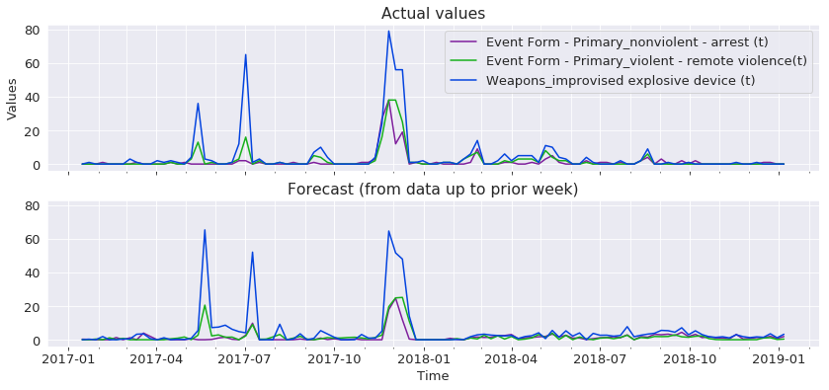
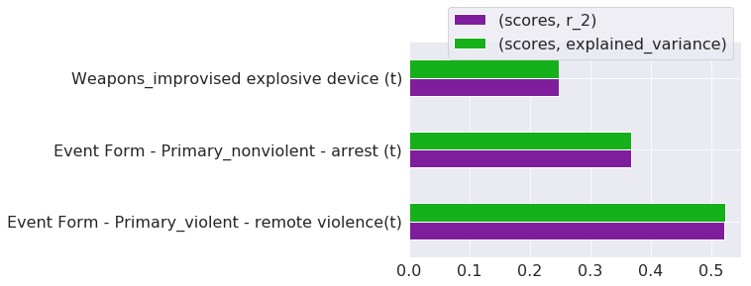
Improvement
In the run above, MLPRegressor (a neural net), significantly improves the accuracy in forecasts over the baseline in multiple tracked variables. Note how the forecast lags a week behind the first two peaks, but the model seems to have “learned” enough to predict the 3rd one.
Notes:
Show improvement on baseline, like slide above. Note how the model slowly learns election related incidents are less likely.

Slide 15
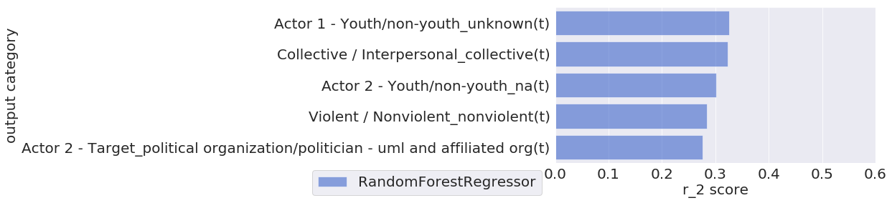
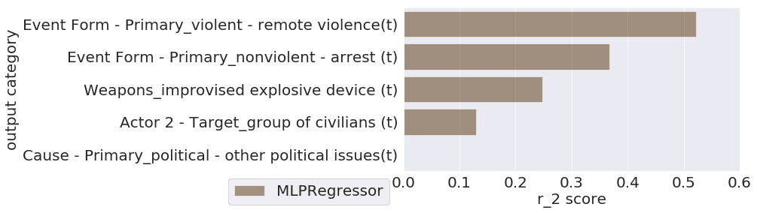
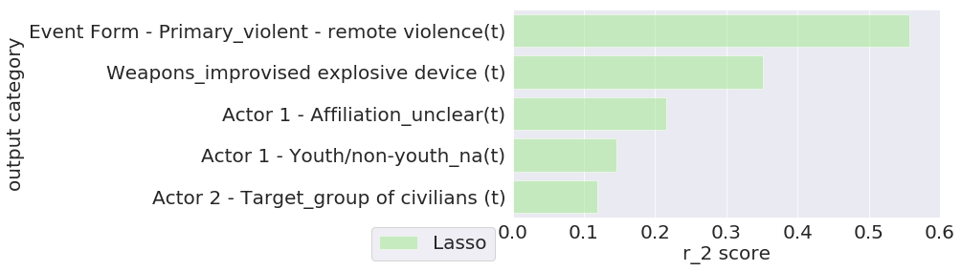
Best Models
RandomForestRegressor performs the best out of all models attempted by showing significant improvement over control in a diversity of categories (Top 5 shown). MLPRegressor, and Lasso score higher in a narrower set of categories.

Slide 16
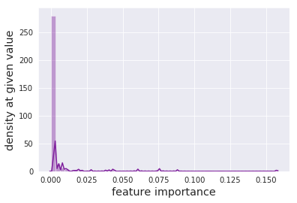
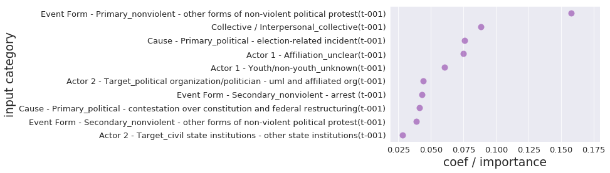
Feature Engineering
Using best scoring model (Random Forest Regressor)
The vast majority of features in the dataset have close to zero impact on predictions. The most important features for prediction can be interpreted by the project as indicators for further analysis, and used for feature pruning to improve efficiency of the models.

Slide 17
Findings
Many of the highest scoring forecasts are for variables that would seem useful for the project to predict. ie:
Improvised Explosive Device
Collective Violence
Total Injured
The most important features for predicting multiple variables were associated with electoral periods. ie:
Non-violent political protest
Collective violence
Election related incidents
It appears certain models can be trained to accurately forecast peaks associated with electoral periods beforehand
Further exploration needed

Slide 18
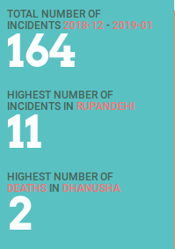
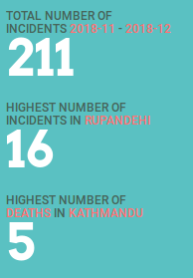
Possible Next Steps
Improve machine learning models:
Add known events (ie: elections), as features into time series data
Use classifier to predict simple increase/decrease in next periods violence
Break time series analysis into provinces/districts
Add population and demographics as features
Use insights from predictive modeling in analysis distributed by NMP.
ie: Explore why Sarlahi experienced less violence
Promote most important features as early warning indicators
Add forecasts using machine learning to analysis products. (running models again with updated data is relatively easy)
This Month:
Forecast:
Add forecasts to Nepal Monitor Platform.
Display forecast estimates for select variables next to previous accuracy (r²), with 95% confidence interval
Significant web development needed to automate
Rough forecast mockup based on current platform

Slide 19
Appendix
Datasets
NepalMonitor.org
2011 census data
Shapefile Export
Project on git-hub
https://github.com/Nhorning/NM_Analysis/tree/ML
Supervised Learning for Time Series
https://machinelearningmastery.com/convert-time-series-supervised-learning-problem-python/

